Slide 1
LAB and Simulation - Vehicle and Traffic Safety
Adipta Laha -- Fikri Farhan Witjaksono -- Jan-Hendrik Duerkop

Slide 2
Task and Test Plan
What is the maximum car weight the existing design can support without encountering problems that the “car” front structure bottoms out?
Test | Distance [cm] | Added Mass [kg] | Velocity [m/s] | Length (post) [cm]
1 | X | 6 | 2.94 | 7.4
2 | X-30 | 4 | 2.7 | -
3 | X-20 | 4 | 2.81 | -
4 | X-5 | 4 | 2.9 | -
5 | X-5 | 4 | 2.9 | 7.6
6 | X-10 | 2 | 2.94 | -
7 | X-10 | 2 | 2.94 | 8

Slide 3
Deformation vs Time and Added Mass
Chose the 2mm mesh, because of the compromise between simulation accuracy and computation time (cost)

Slide 4
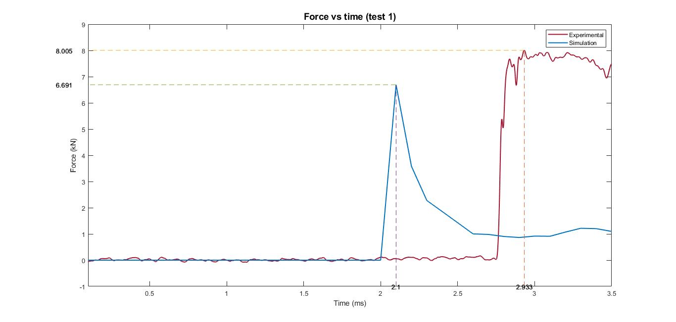
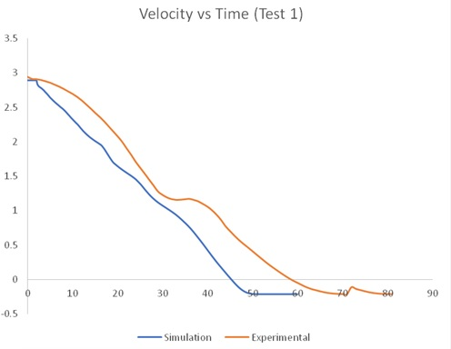
Validation of data
Validation of the can thickness is done by comparing the above graphs.

Slide 5
Result
Simulation | Test | Added Mass (kg) | Deformation [mm]
 | 1 | 6 | 66.3
 | 2 | 4 | 62.9
 | 3 | 2 | 58.9
Keep adding mass in the simulation
→ higher deformation
Bottomed Out (85% Deformation) | - | 50,1 | 120

